Slide 1
HOW TO BECOME AN IT SUPERHERO!
Holy Business Boost!

Slide 2
Typical Small Business Tech Environment
Organic growth, unstructured
Risk: Network vulnerable to hackers/malware
Using Google/Dropbox for File Sharing
Risk: Not secure, risks data theft and malware infection
No malware protection or network security
Risk: Ransomware attacks and slow network
Using a free email service
Risk: blacklisting, insecure, adware and potential for effective malware attacks

Slide 3
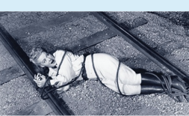
Cloud vs. On-Premise Storage: Are You Vulnerable?
When on-prem servers are reaching end of life, consider the cloud.
Public Cloud isn’t local (Google, AWS, Azure). No idea where your data is.
Private Cloud means you know where your data is, and who’s guarding it for you – is your data encrypted?
Moving to the cloud saves on hardware, power, and internal labor costs and makes office relocation much simpler.
Backups kept in the same office are no safer than your computers, in case of disaster, theft or a malware attack.

Slide 4
Malware & Ransomware: The Villains of IT
Malware causes $3 TRILLION worth of damage every year (worldwide)
Ransomware attacks cripple your computers, ruining productivity for days or weeks
Best defense: Prevention
Second best: Good up-to-date backups stored offsite
Ransomware can even destroy local backups. Keep them in a secure cloud!
Malware Costs: http://bit.ly/2ckcYci

Slide 5
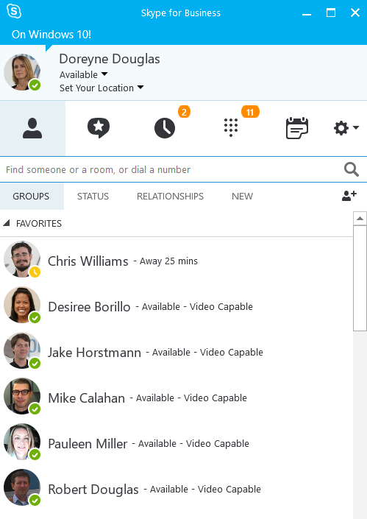
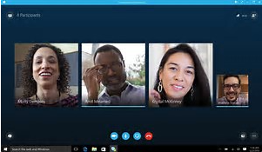
Unified Communications: The Future is Now
Most feature-rich example is Skype for Business
A complete business phone system including mobile app
Secure instant messaging/video chat with internal and external users
Online presence awareness
Screen sharing and video conferencing (replaces WebEx, GoToMeeting, etc.)
Voicemails recorded and transcribed and sent to your inbox
No separate phone line; voice over IP uses your internet line (preferably SIP enabled). Calls within your company’s offices, even international, are free.
Can be hosted on-prem, via Office 365, or in a private cloud
RingCentral is another option—subscription based, fewer features

Slide 6
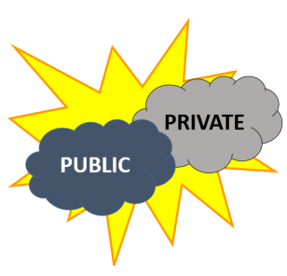
File Sharing: Is There a Better Way?
Using Google Docs, Dropbox or Box? It’s not entirely safe! “Dropbox used by Chinese hackers to spread malware” http://nbcnews.to/P7hQQi
Risk of data theft, internal and external
Google Docs, Dropbox and Box are the public cloud; no way to know where your data resides.
Private cloud file sharing options exist. Built-in security, business-grade, do everything Dropbox does & more.
Dropbox recently had a major security breach: http://bit.ly/2016DropboxBreach

Slide 7
IT Support Models: What Fits Your Company?
Model 1: All Internal IT Staff, “Local”
Pros – Support always on hand (at least between World of Warcraft battles); knows your IT environment; dedicated to the company.
Cons – Overhead (almost 75% of the average IT budget goes to labor); benefits, paid vacation/sick time, technical training costs; tend to stick with solutions in their comfort zone; will need to augment their expertise with outside consultants if their skills fall behind.

Slide 8
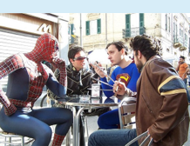
IT Support Models: What Fits Your Company?
Model 2: All External IT, “Consulting”
Pros – Broad range of skillsets; leads to faster resolution; established relationships with vendors; network monitoring typically employed; on-demand workforce.
Cons – Hourly rate for consultants is higher on average than full-time workers; time required to get onsite in emergencies (though remote access has reduced this); some companies offshore their consulting work which can lead to service quality issues.

Slide 9
IT Support Models: What Fits Your Company?
Model 3: Internal/External IT, “Hybrid”
Pros – Task-based outsourcing without interrupting everyday systems; benefit outside expertise and the long- term dependability of on-site staff; full-time staff can gain cross-training from consultants with field-proven expertise.
Cons – Must manage and prioritize who does what; must maintain a cost/ROI balance; internal staff may not cooperate with external consultants (feelings of encroaching on their turf).

Slide 10
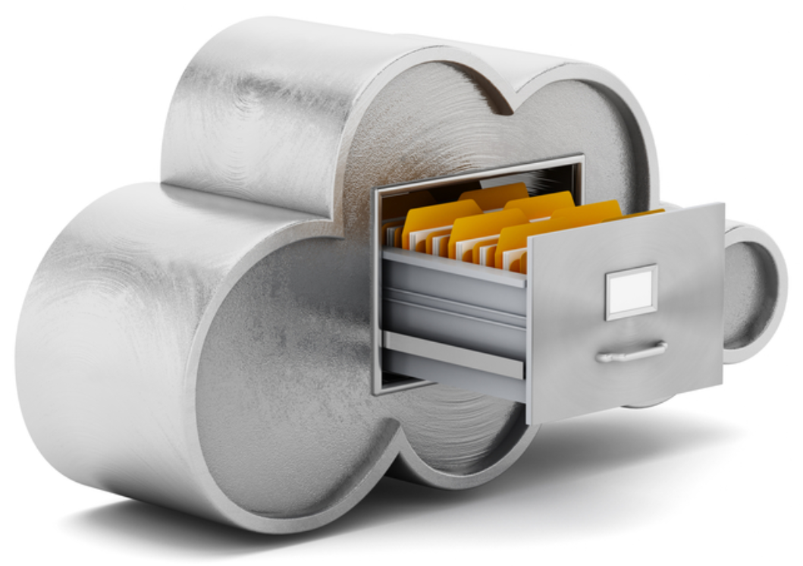
IT Support Models: What Fits Your Company?
Model 4: The Cloud/SaaS Option
Pros – Easy to scale cloud services; no hardware to purchase; server maintenance handled by the cloud provider; allows for fewer full-time staff and/or IT Consultants.
Cons – Monthly hosting fees, fees for exceeding contract; limited high-level support; may need to upgrade your office’s infrastructure to harness the full power of cloud services; can’t completely disengage your outside IT Consultants, still need desktop support.

Slide 11
IT Secrets of the Bat Cave
Internet contracts can auto-renew!
Always have two forms of backups
Don’t use a solo IT guy (no offense, Alfred)
Don’t use free services to run your business (if you’re not the customer, you’re the product)
Buy business grade network gear—not home grade
No BYOD

Slide 12
Becoming an IT Superhero
Build & maintain a network that “works,” so everyone can do their jobs
Bulletproof your network and protect your company’s IP from crooks and other unsavory jokers
Save the day when things go wrong by making sure you have super-powerful IT partners at your command!
Co-workers will know and respect your “superpowers”

Slide 13
About PlanetMagpie
Comprehensive IT Services Provider
Magpie (left) was our co-founder
Serving Businesses across the Bay Area and U.S. since 1998
Microsoft Gold Partner since 2005
Choose the IT solutions you need
Join our mailing list to receive WOOF!
Enter raffle at Booth 311 to win an hour of free IT Consulting

Slide 14
Q&A SESSION – PLEASE ASK YOUR IT QUESTIONS!

